Slide 1

PREDICTIVE analytics PREVENTIVE Maintenance Model
Raghu Raman Nanduri
DSC 680

Slide 2
Business Understanding:
In manufacturing industries, downtime for heavy machinery costs lot of dollars both in terms of idle time lost due to repair work and also repair costs. If the businesses can be pro-active and perform regular maintenance tasks proactively along with predicting issues before hand using historical data, it would be a huge boost to their bottom line. In lieu of that industries usually employ IOT (Internet of Things) sensors to monitor and gather readings from various telemetric sensors. By merging telemetry data and failure reports, a predictive model can be built that can predict future fault occurrences of the heavy machinery.
Business Goal:
The end goal is to create a proactive maintenance strategy that tries to predict future failure of various components in heavy machines. As mentioned earlier, it benefits the businesses by reducing operational costs, long term maintenance costs and maximizing production hours.

Slide 3
Data Understanding:
The following data sources were considered for building this Predictive Maintenance Model.
Telemetry : Time series data consisting of various measurements like - Voltage, Rotation, Pressure and Vibration readings from various machines.
Machines : Information about machines.
Failures : Records of failed components.
Maintenance : Maintenance historical records of machines involving component replacements due to regular maintenance activity or due to failures.
Errors : Historical errors thrown by the machines.
Below links has instructions to get data sets for this project. https://gallery.azure.ai/Experiment/Predictive-Maintenance-Implementation-Guide-Data-Sets-1
Project Link:
Project related analysis can be found in “Predictive Maintenance Model” section of my portfolio site, mentioned below.
https://iamnrr.github.io/

Slide 4
Exploratory Data Analysis

Slide 5
Below is the list of variables in each data set.
Telemetry data set has below variables:
datetime
machineID
volt
rotate
pressure
vibration
Machines:
machineID
model
age

Slide 6
3. Errors:
datetime
machineID
errorID
4. Maintenance:
datetime
machineID
Comp
5. Failures:
datetime
machineID
Failure

Slide 7
Target Variable:
As per the business goal, the variable that I am trying to predict here is the component that is going to fail, it could be any of the components - comp1, comp2, comp3, comp4 or none of them. The history of this failure data is in “Failure.csv”

Slide 8


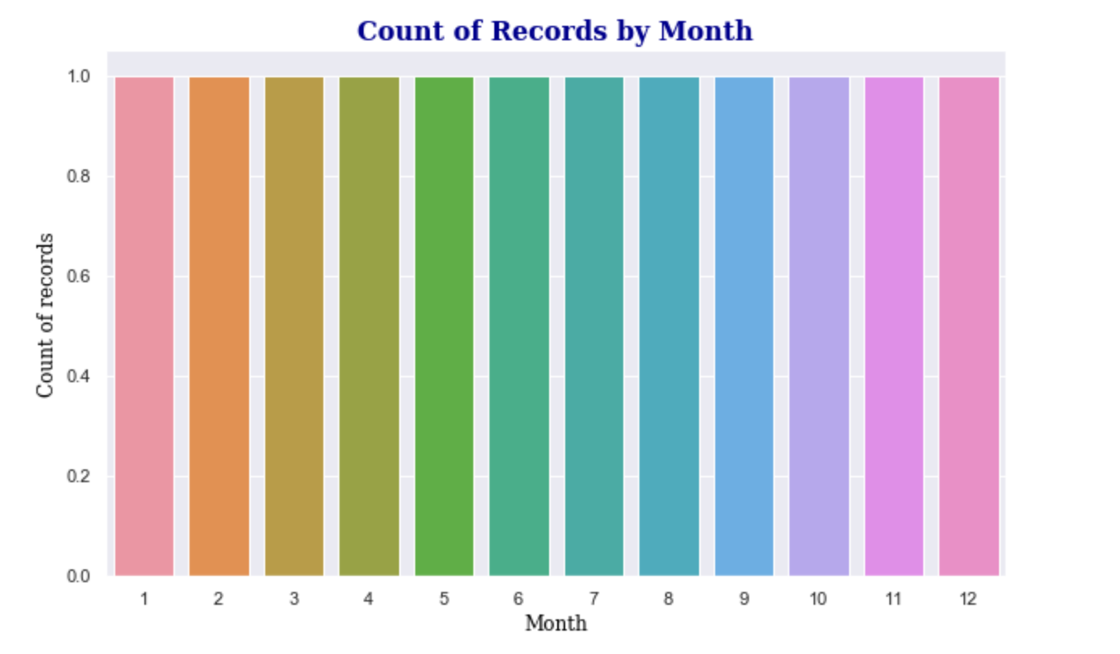

Slide 9
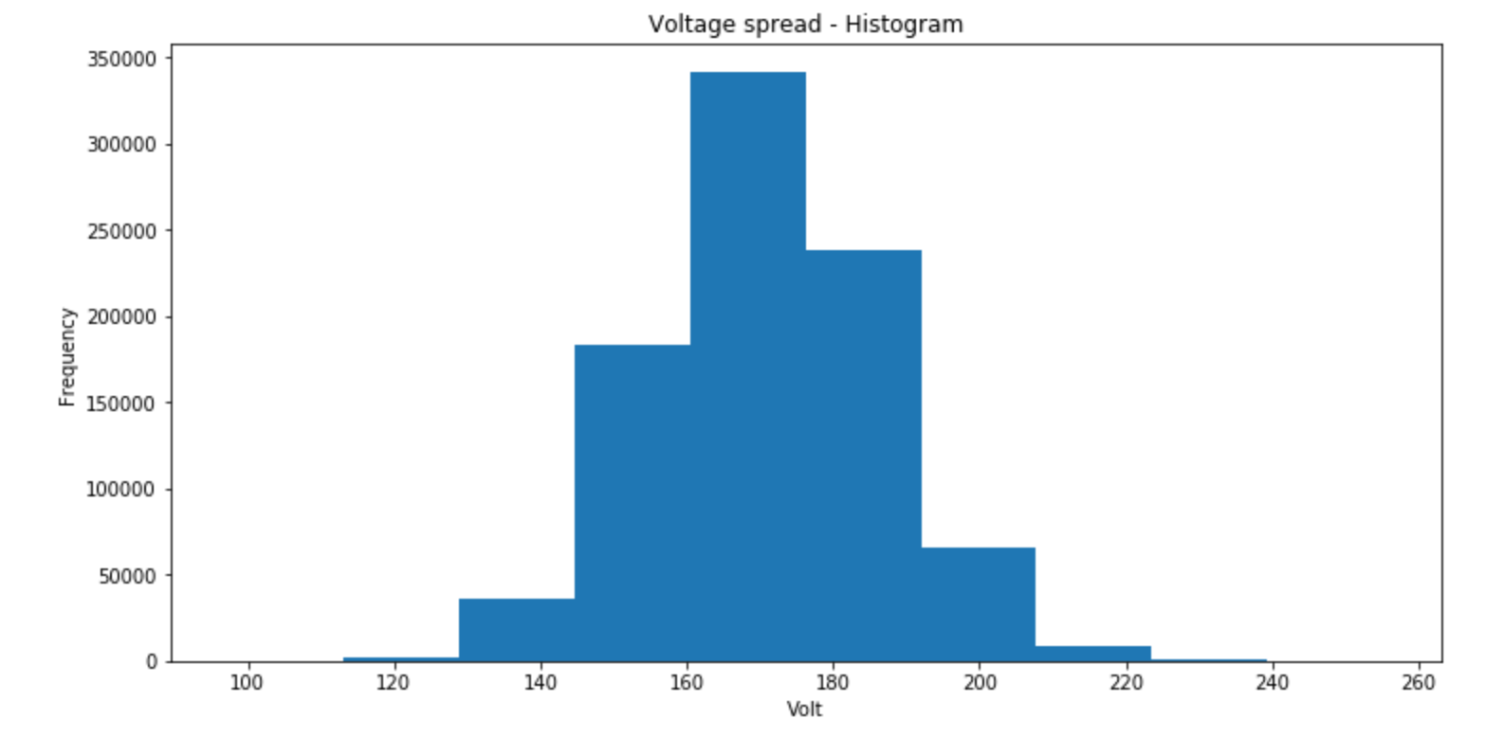

Slide 10
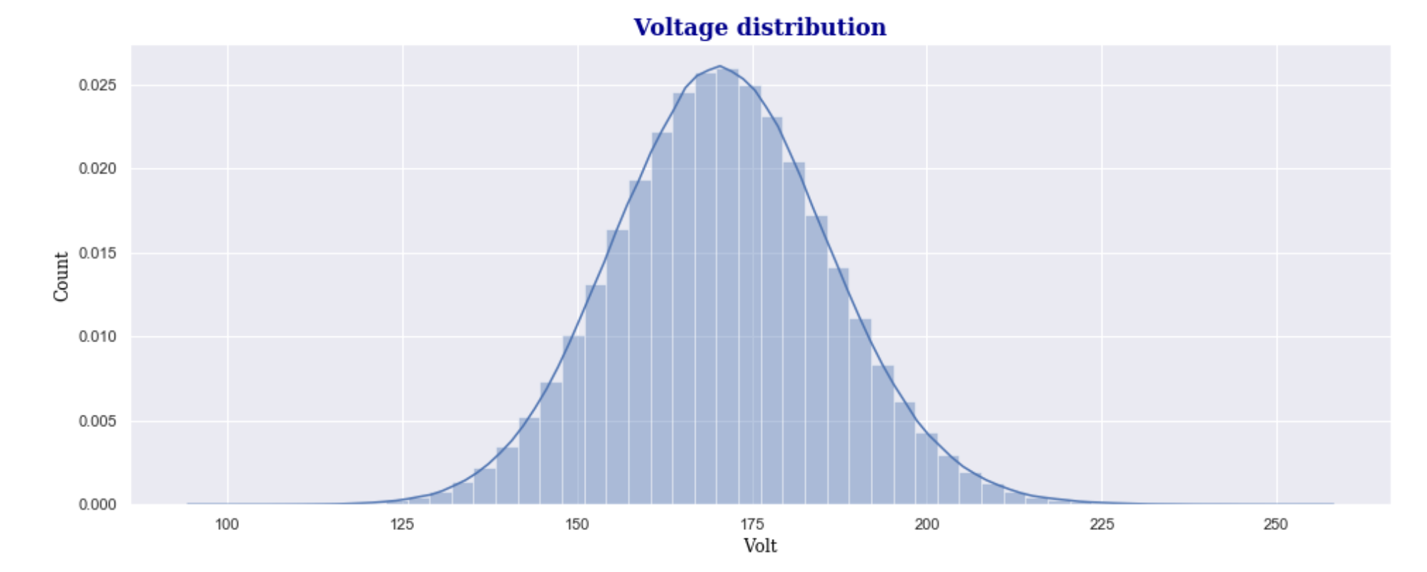
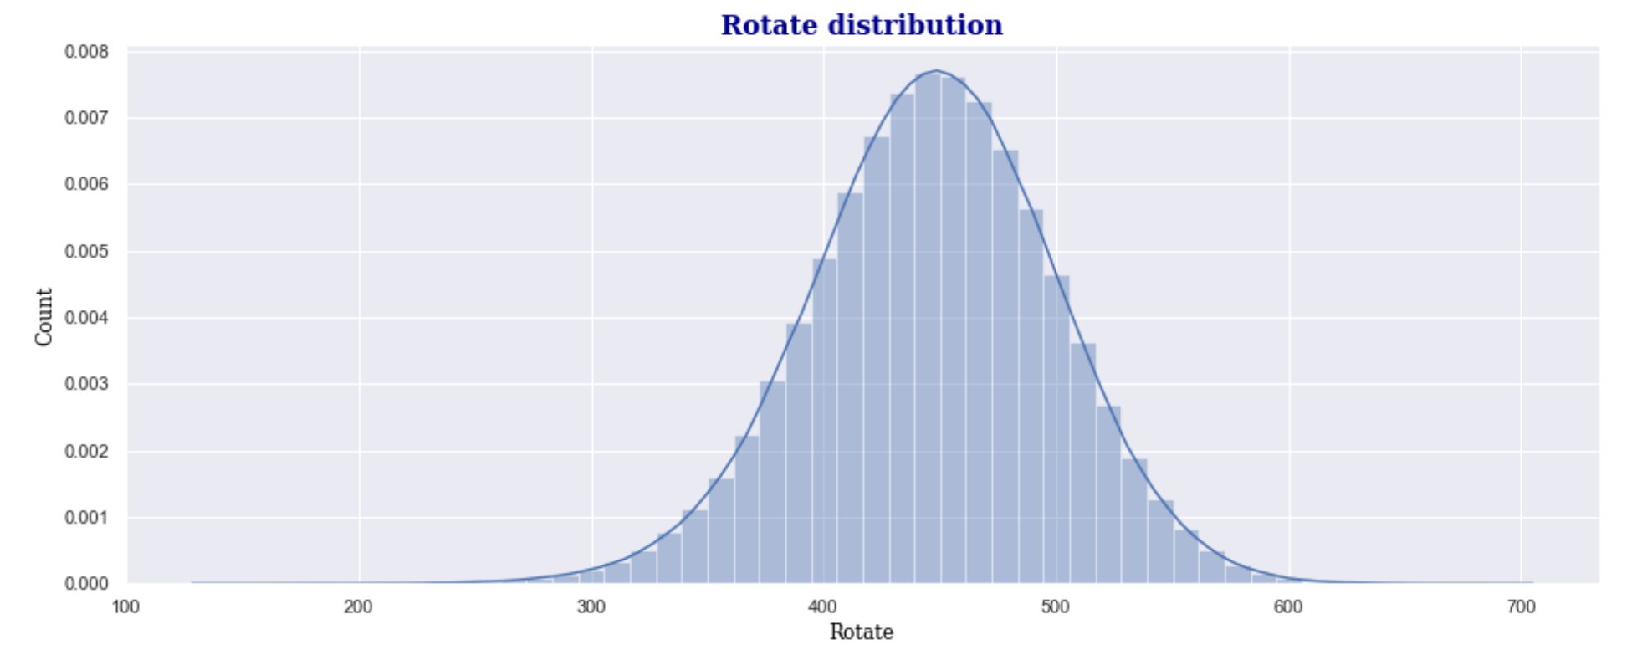
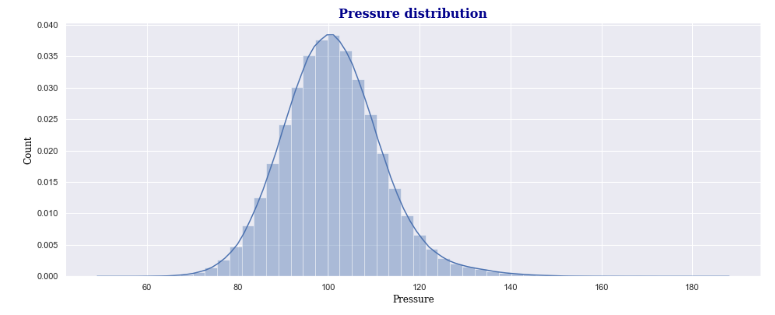
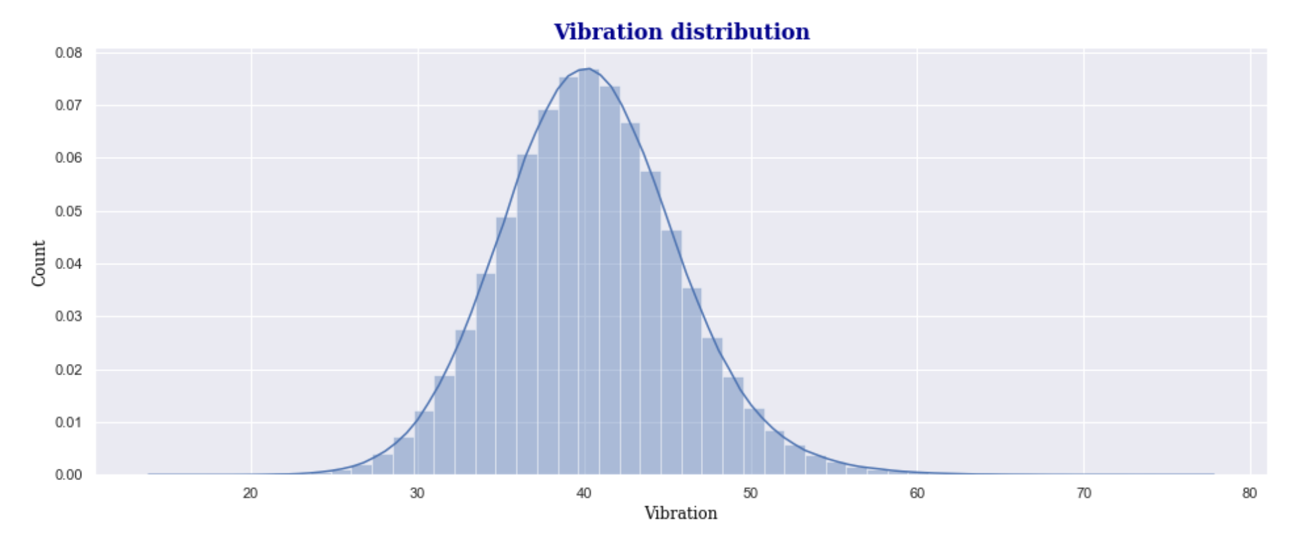

Slide 11
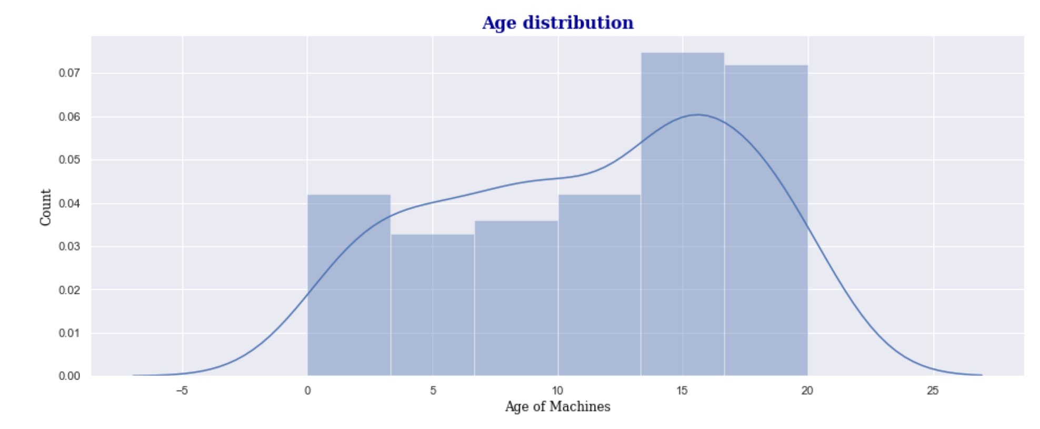

Slide 12
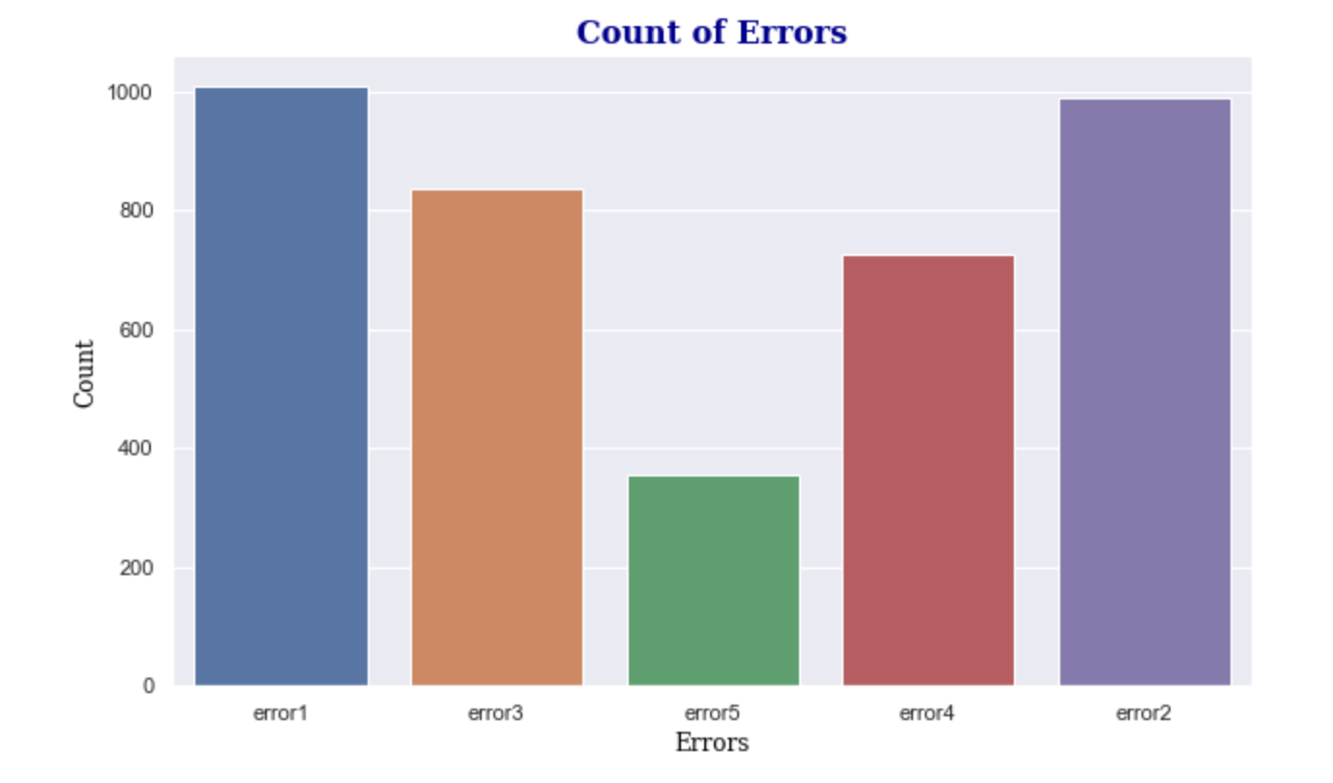
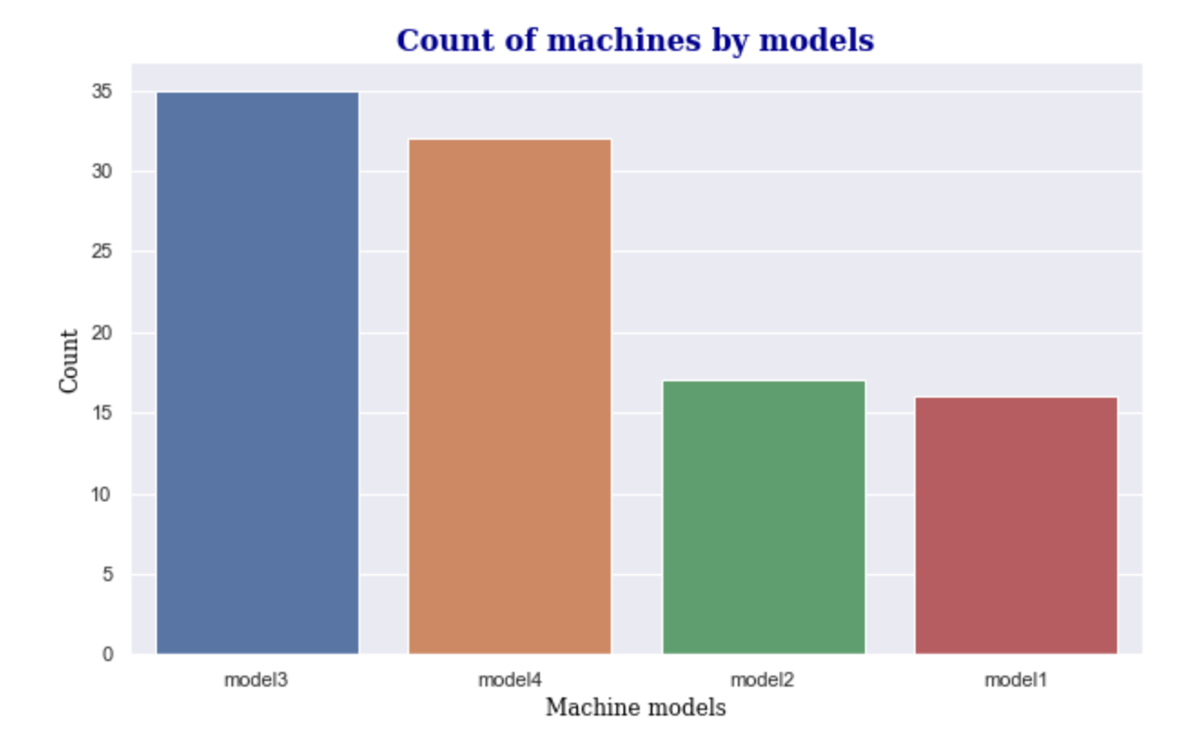
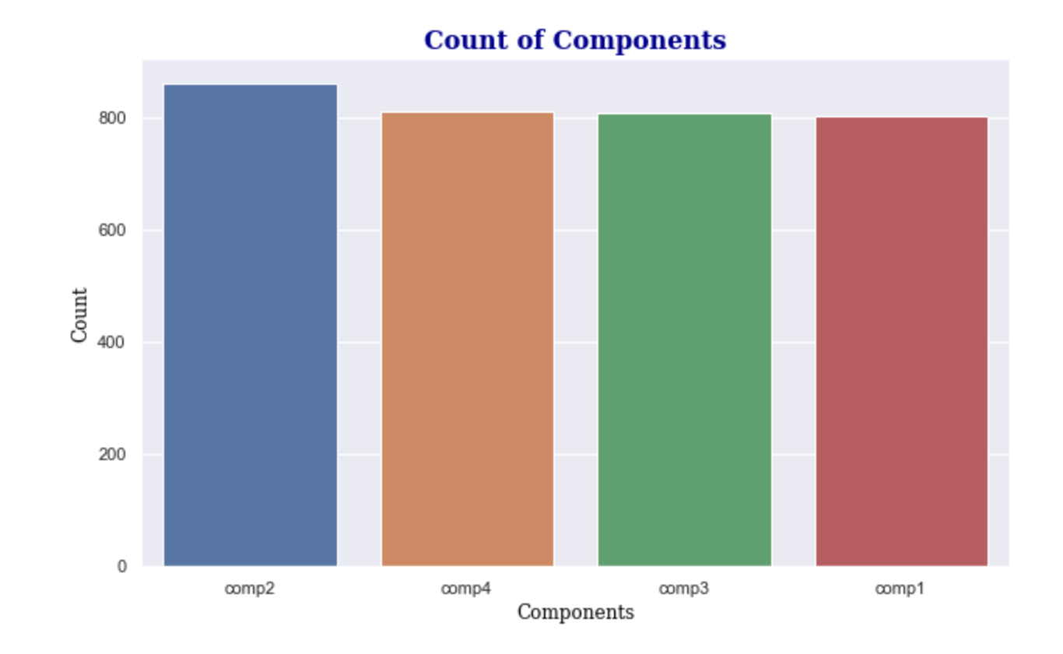
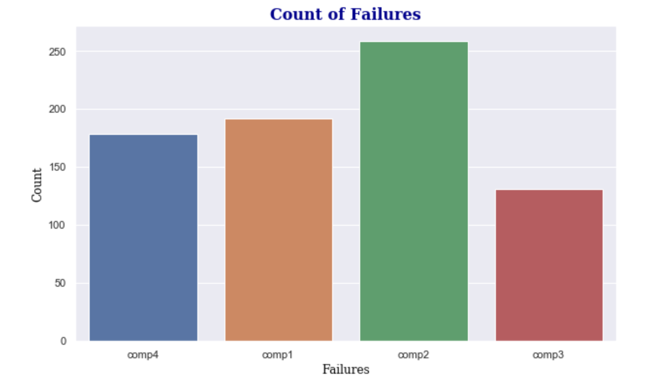

Slide 13
Feature Engineering

Slide 14
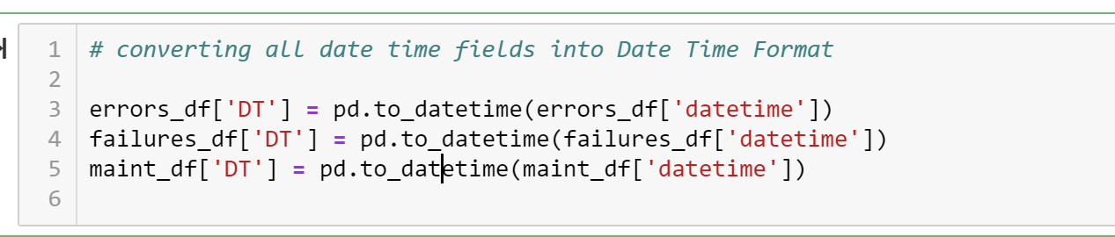

Slide 15
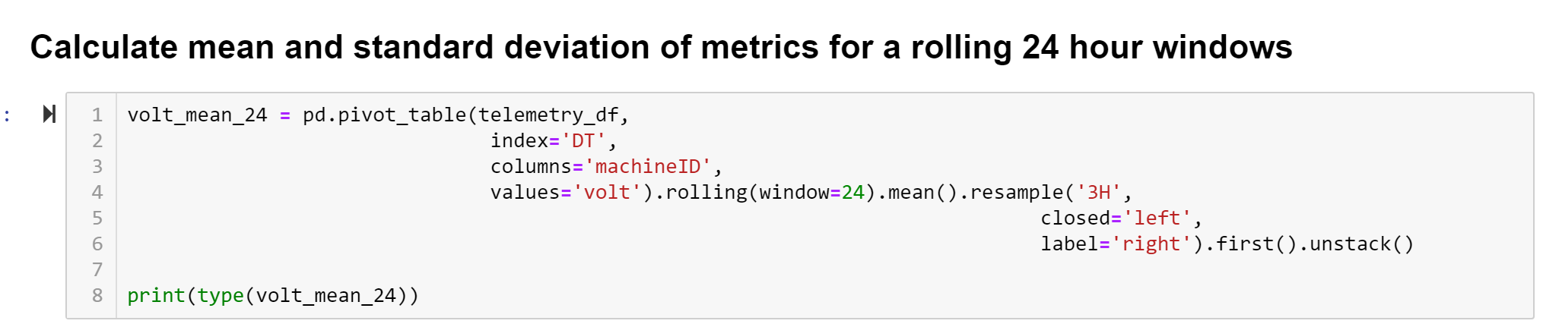

Slide 16
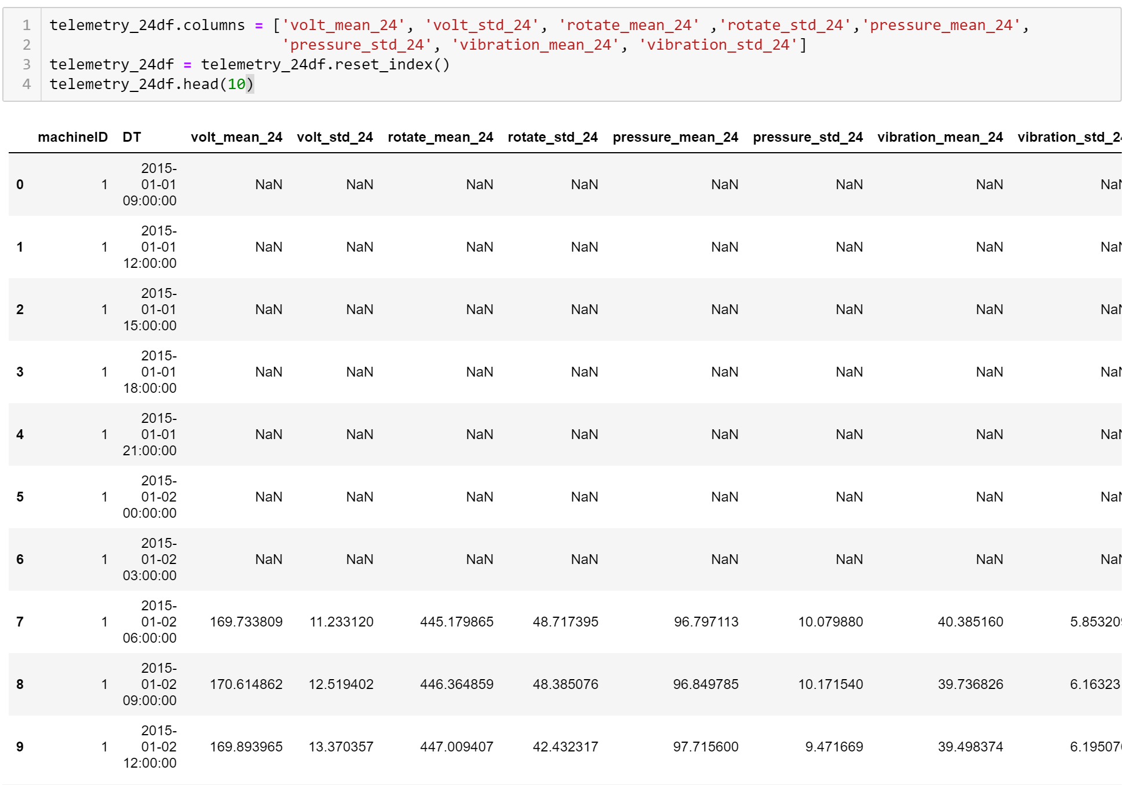

Slide 17
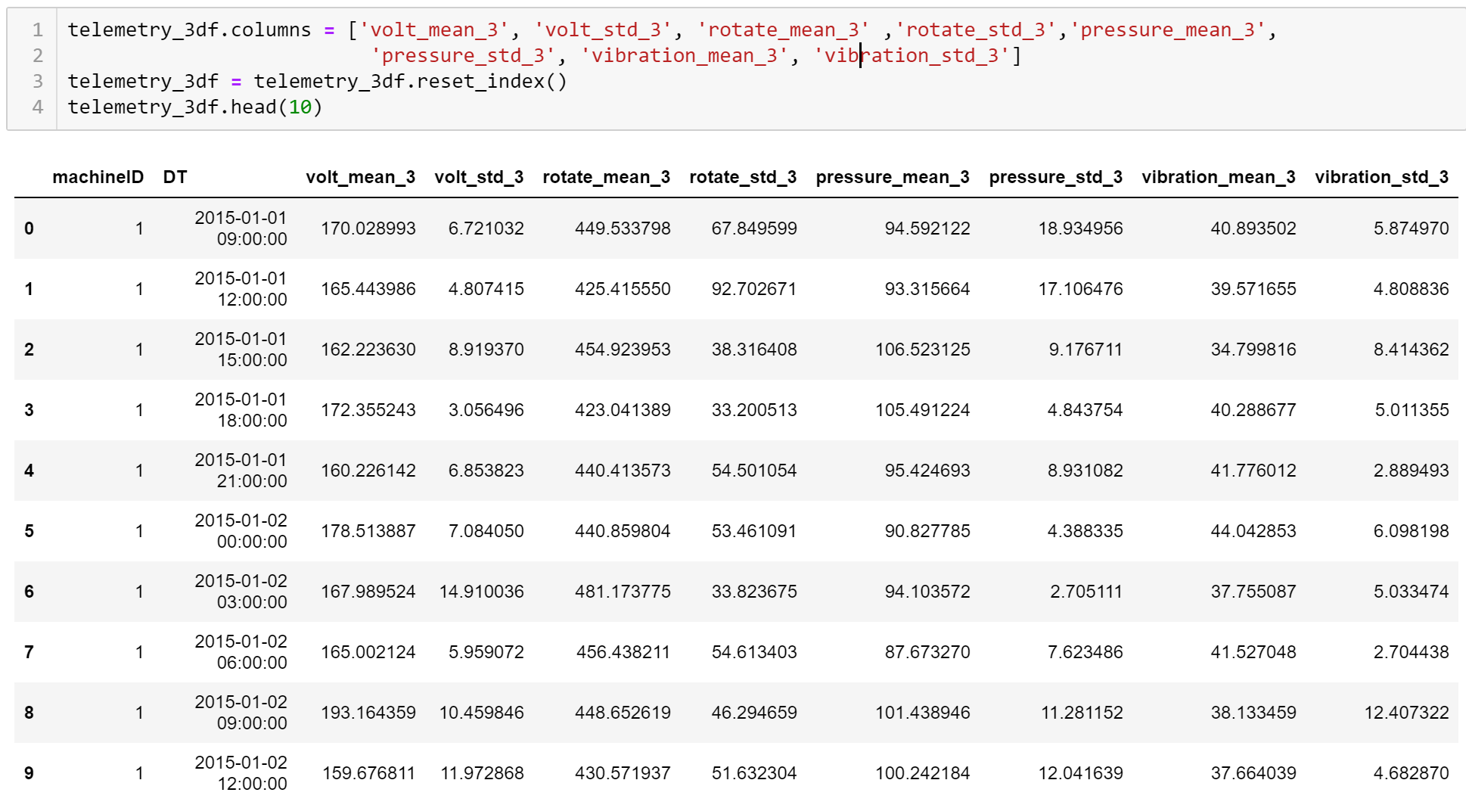

Slide 18
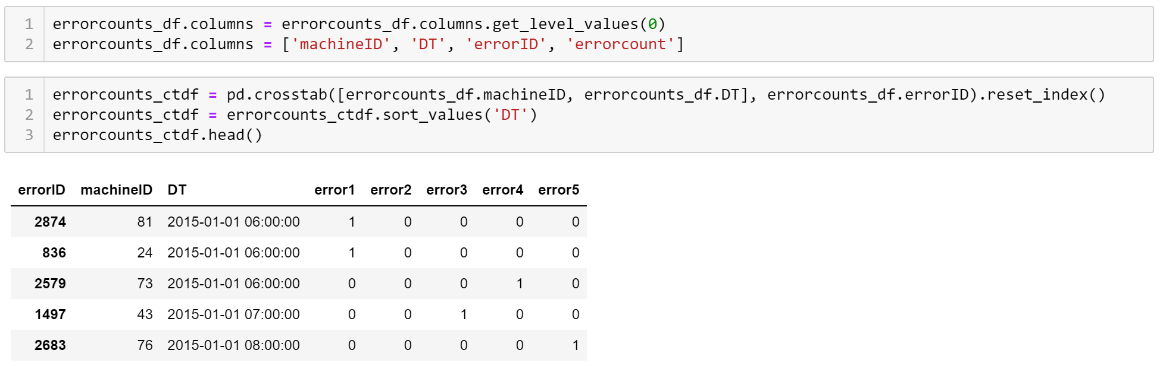

Slide 19
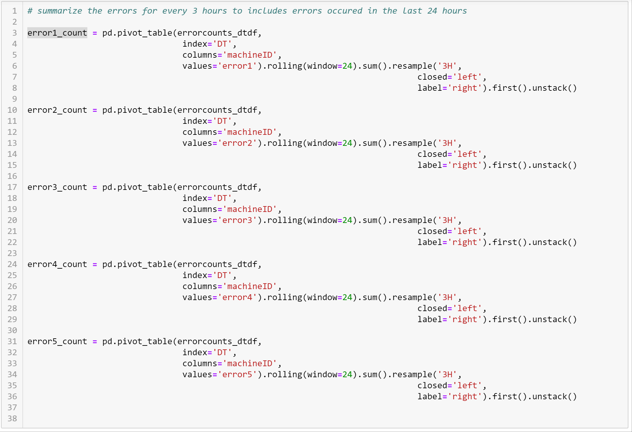

Slide 20
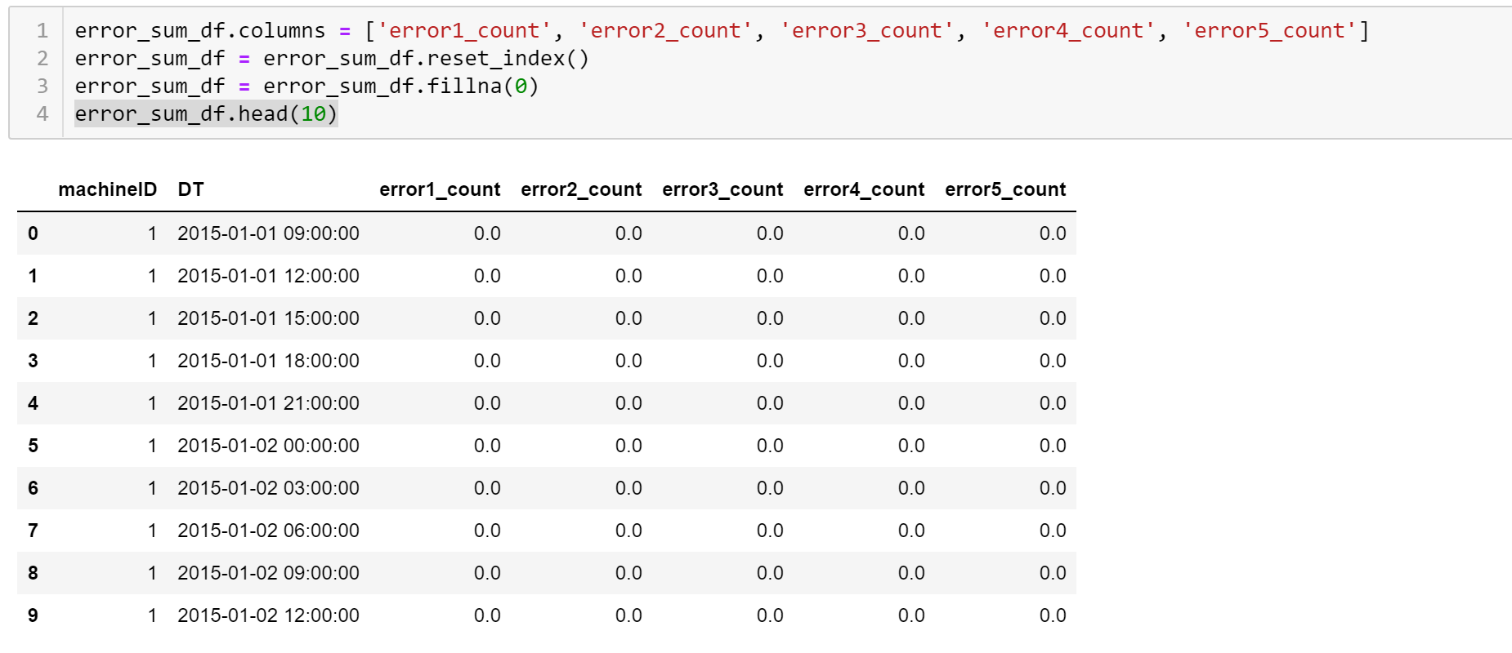

Slide 21
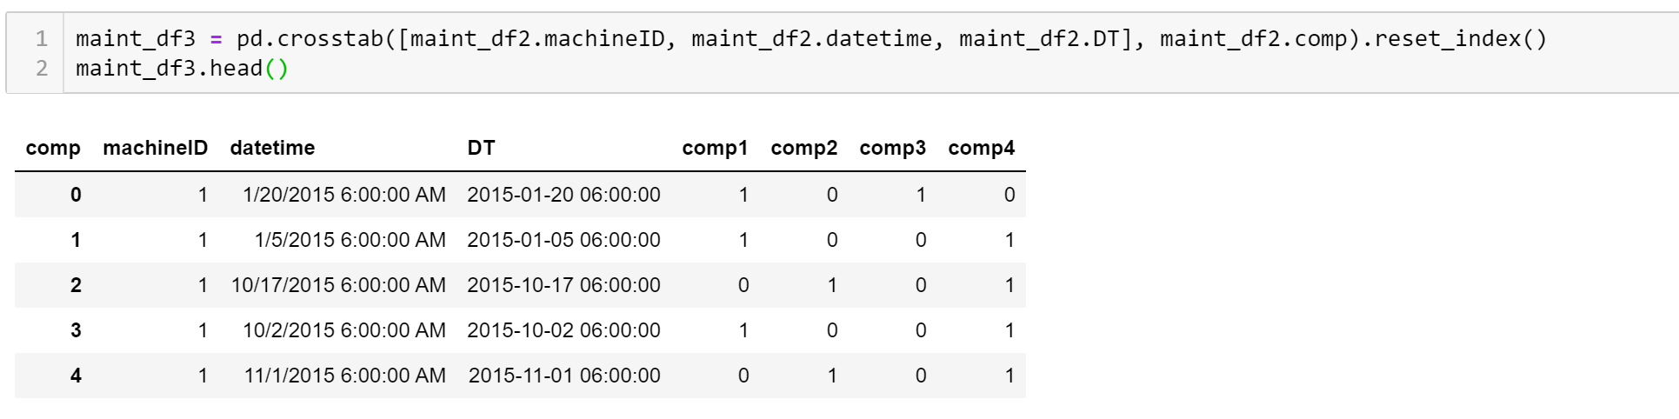

Slide 22
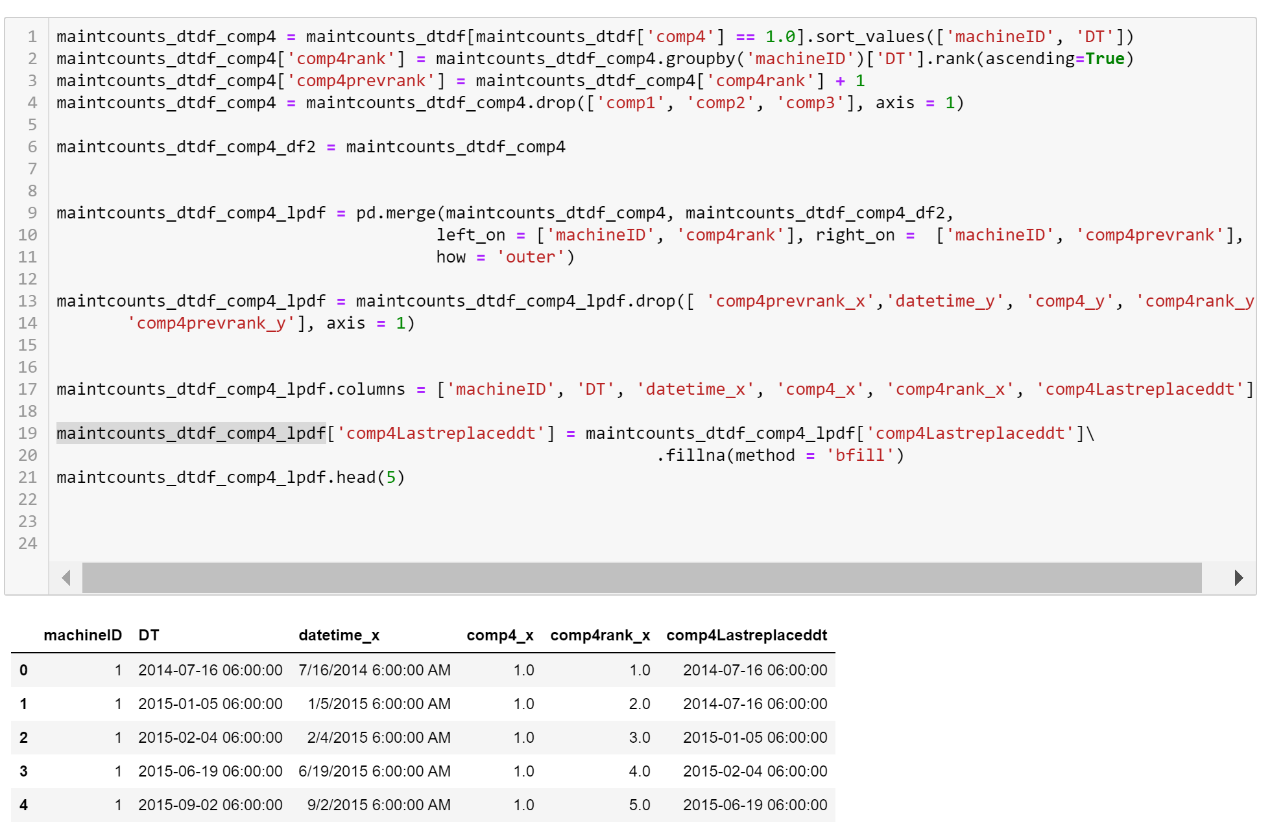

Slide 23
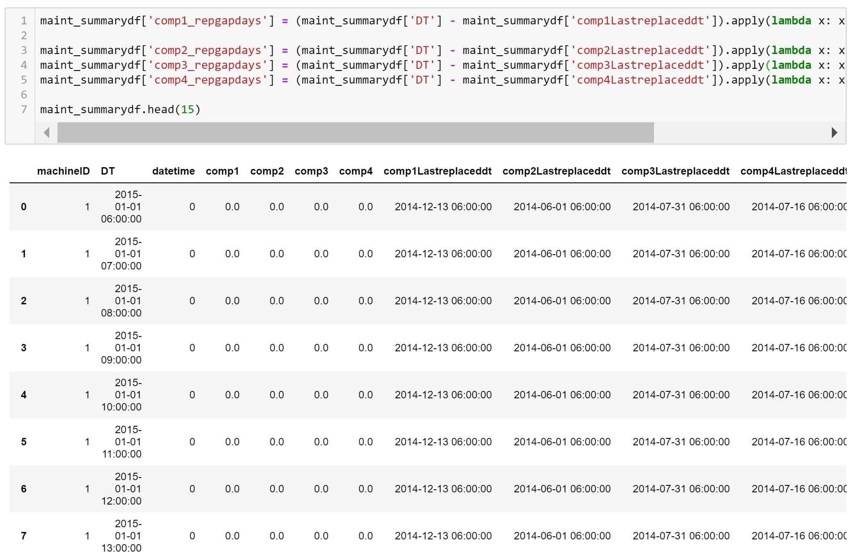

Slide 24
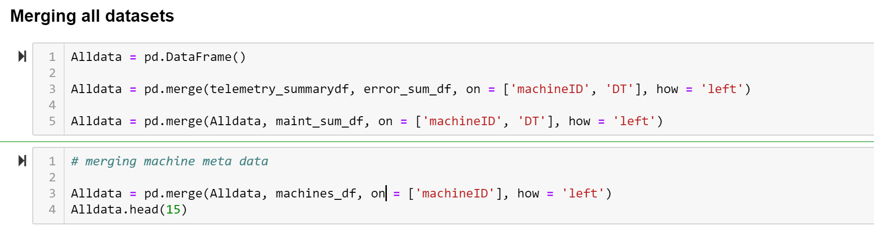
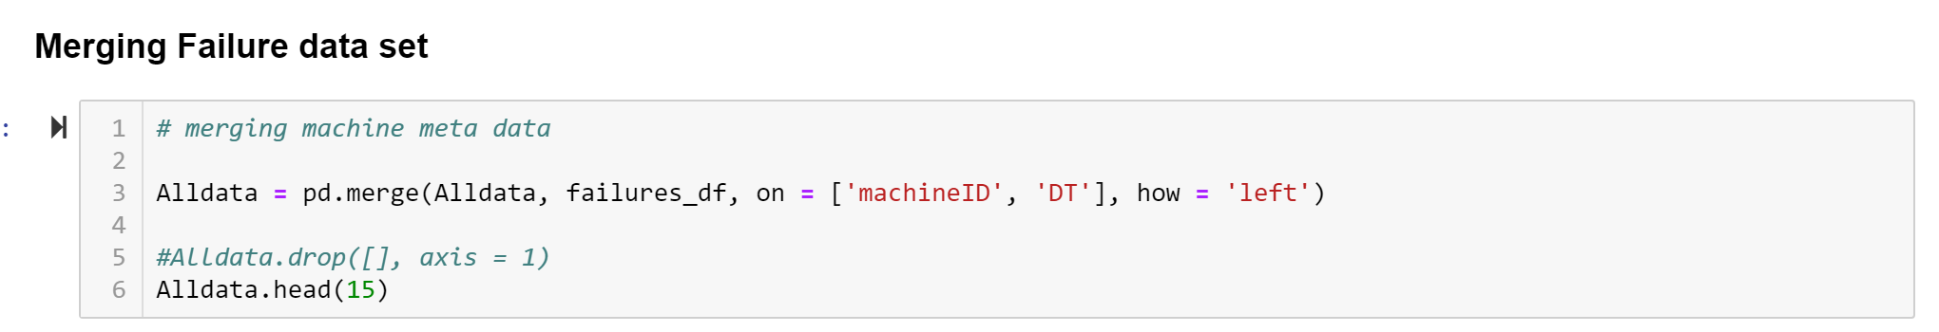

Slide 25
Predictive Modeling
Model Training

Slide 26
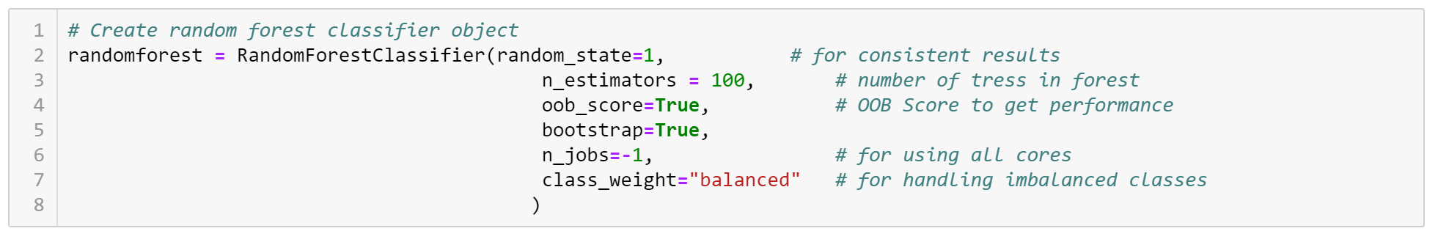

Slide 27
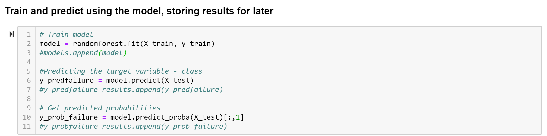
Random splitting of data for creating training and testing data set does not make sense as failures and errors are time series-based events. So, for this exercise I have split the train data and test data based on the dates.

Slide 28
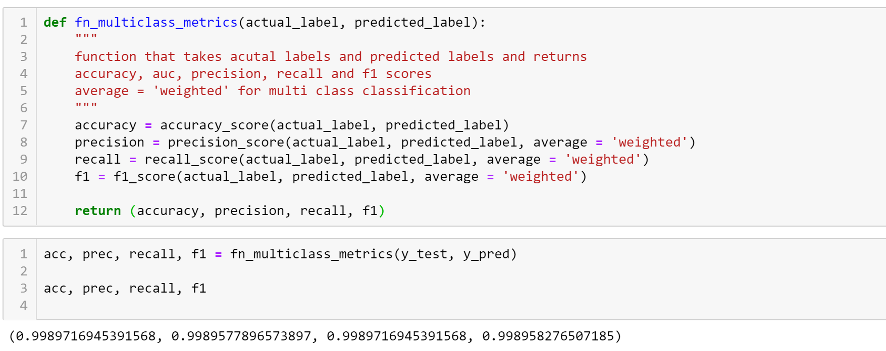
Model Evaluation
In preventive maintenance prediction, the most important metric to evaluate the model is recall, which conveys the actual number of failures predicted by the model. Here in the model built. it is around 99.8%. I suspect this could be due to large portion of failure = 'none’.

Slide 29
Model Tuning
While I did accuracy and recall of above 99%, I think the model is slightly biased. The model can be further improved considering the technicalities in generating different feature variables in the preventive maintenance. Different kind of classifying algorithm like Gradient Boosting Classifier or Deep Neural Networks can be used to improve the model further.

Slide 30
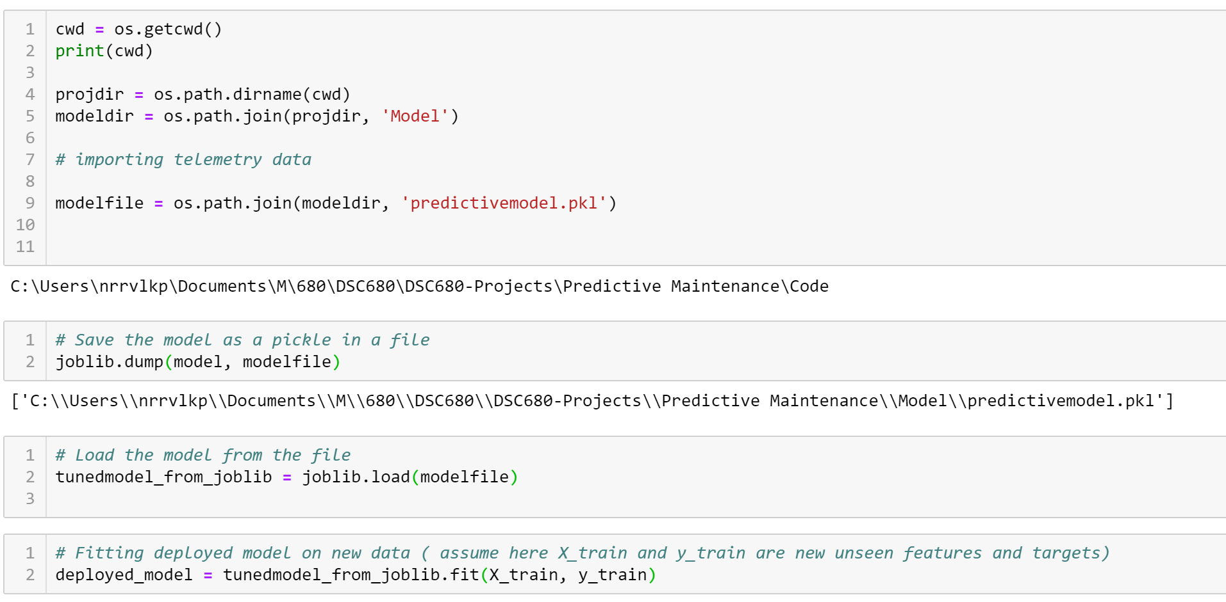
Model Deployment
Create the model with best parameters obtained from tuning
Save the model using joblib module as a pickle
Deploy the pickle on the server and use it for fitting new unseen data

Slide 31
Conclusion
Performance of the model can be further improved upon using Deep Learning and Neural Networks.
Project Code: https://github.com/iamnrr/DSC680-Projects/tree/master/Predictive%20Maintenance
Git Hub Portfolio: https://iamnrr.github.io/

Slide 32
Thank You

